Slide 1

OpenShift 4.x Architecture Workshop
Enterprise Registry QUAY
July 2019

Slide 2

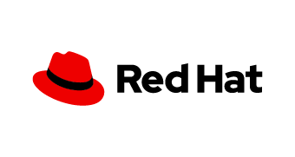
What Is Quay?
Market leading enterprise container registry
Available on-premise, on public cloud and as a hosted service (SaaS)
Key strengths:
Security
Robustness & speed
Automation
Quay works with any container environment or orchestration platform
RED HAT QUAY
First hosted registry in the market with private repos
2nd biggest hosted registry overall
Notes:
Short history
Quay.io was the first hosted registry with private repositories
Quay was acquired by CoreOS in 2014 to introduce the first Enterprise Registry
Today, Quay.io hosted service delivers tens of terabytes of container images per day
Today, many Quay Enterprise customers run larger deployments as large as Quay.io itself

Slide 3
Red Hat Quay Feature Highlights
Security | Robustness and Speed | Automation
Support multiple authentication systems and identity providers | High availability & scalability | Build triggers
Vulnerability scanning | Geo-synchronous replication | Git hook compatible
Encrypted CLI passwords | Continuous, zero-downtime garbage collection | Robot accounts
Detailed logging for auditing | Torrent Distribution | Webhooks
Orgs & team support | Integration with multiple storage backends | Extensible API

Slide 4
Quay Use Cases
Large-scale and distributed environments (thousands of users and images)
Customer has multiple OpenShift/Kubernetes clusters (content ingress)
Customer needs OpenShift/Kubernetes in multiple geographical regions
Customer needs governance for container images (scanning)
Customer has high image maintenance and automation requirements
Large number of build and high requirements on image delivery throughput

Slide 5

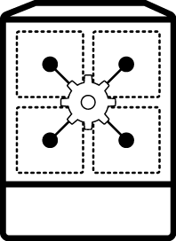



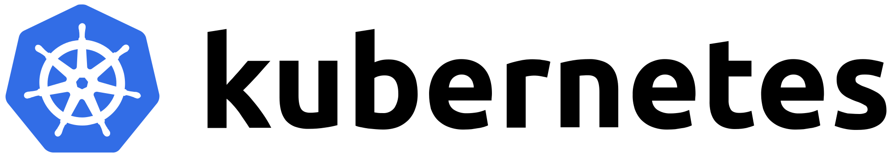



Content Ingress with Quay
Container Catalog (RHCC)
QUAY
Docker Hub
security scan lifecycle mgmt image history webhooks
Other Registries
Notes:
Red Hat recommendation is to use Quay as the content governance and content ingress point used by one or more OpenShift / Kubernetes clusters inside the customer environment
Images are pulled from various sources like Red Hat Container Catalog, Docker Hub and other registries into Quay which is used as the single point of entry for any image content that needs to get consumed within the organization. Images are scanned, managed and governed in Quay and from there they are distributed to various OpenShift, Kubernetes and container hosts that customers have in their various environments.

Slide 6


Quay as Upstream Registry with OpenShift
RHCC
OPENSHIFT
Images pulled from Quay into the integrated OpenShift registry
Images are pushed to the integrated OpenShift registry, and synced externally with Quay
Builder Image
pull
QUAY
Registry
push
Build Config
App Image
App Pod
Deploy Config
pull
Notes:
Red Hat recommendation is to use Quay as the content governance and content ingress point used by one or more OpenShift / Kubernetes clusters inside the customer environment
PROS
Image are available local to OpenShift deployments
Deployments don’t rely on Quay availability
CONS
Extra step for sync images between Quay and OpenShift
Note that use of image streams make this setup simpler to pull images from Quay into OpenShift registry and then deploy

Slide 7
Quay as OpenShift Registry
RHCC
OPENSHIFT
Builder Image
pull
Images are pushed directly by builds to Quay
Images are pulled directly from Quay
QUAY
push
Build Config
App Image
App Pod
pull
Deploy Config
Notes:
PROS
Single source of truth for managing images lifecycle
CONS
Bandwidth implications unless Quay geo-replication or OpenShift local mirroring is used
Deployments rely on Quay availability
Pattern (1) is commonly used by customers for DEV/TEST and pattern (2) for PROD

Slide 8
Quay Architecture

Slide 9
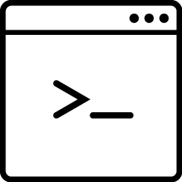

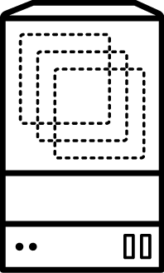
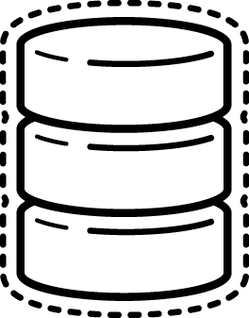
Quay Architecture
CLIENT
LOAD BALANCER
QUAY SERVER
REDIS
DATABASE
BUILD WORKERS
DISTRIBUTED STORAGE

Slide 10

Quay Architecture with Image Scanning
CVE DATA
CLIENT
LOAD BALANCER
QUAY SERVER
CLAIR SCANNER
REDIS
POSTGRESQL
DATABASE
BUILD WORKERS
DISTRIBUTED STORAGE

Slide 11
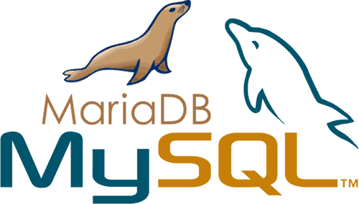
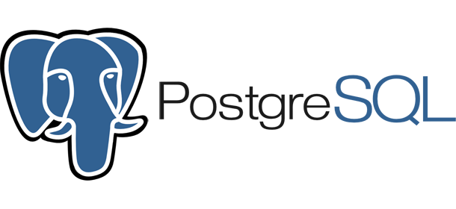

Prerequisite 1: Supported Database
Available via Red Hat Software Collections but 3rd party works as well
Always favor PostgreSQL
Clair requires PostgreSQL due to use of recursive queries.
Great for demo/testing
Only MySQL 5.7+
RECOMMENDATION: Customers should have DBA group manage the database, or to use a managed database solution such as RDS.
Notes:
DO NOT use Galera for database high availability as it does not work in a consistent way and leads to failure

Slide 12
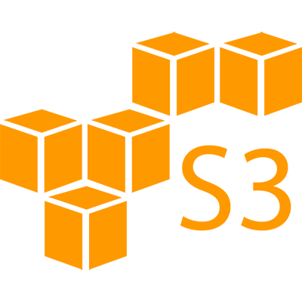

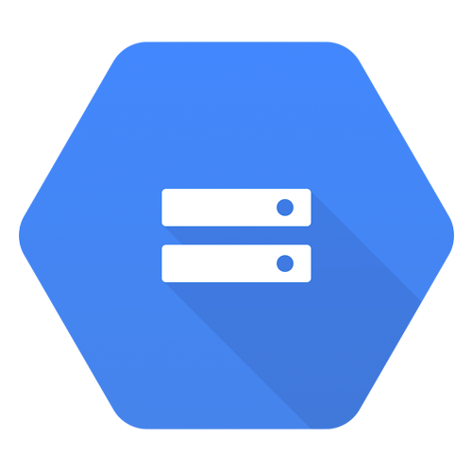

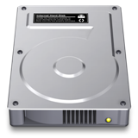

Prerequisite 2: Storage Engines
AWS S3
Google Cloud Storage
Ceph Rados
OpenStack Swift
Azure Blob Storage
Local Disk Mount (NAS)
Red Hat Gluster Storage Support planned for future releases of Quay.
NOTE: Local Storage and NFS not recommended (see next slide)

Slide 13
Prerequisite 2: Storage Engines
Local Storage only for PoC / non-prod environments!
Geo-replication is not supported with local storage!
No way to switch to another storage engine
NFS not recommended for large-scale and production environments!
Many customers will attempt to use the local storage engine with NFS. Always steer customers toward another storage engine unless there is literally no other option.

Slide 14
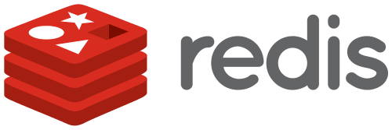
Prerequisite 3: Redis Cache
Provided via Red Hat Software Collections but any other redis works, too
Mostly used by builds, workers and tutorial
Data stored is ephemeral in nature, Redis does not need to be HA.
If Redis goes down you will lose access to:
Live build logs
Tutorial

Slide 15
Quay Setup Sizing Recommendations
As for any other product there are no “typical sizing recommendations” since sizing heavily depends on a multitude of factors
However, the scalability of Quay is one of its strengths (Quay.io)
Stateless components can be scaled-out
Auto-scaling on kubernetes deployments currently tech-preview
Note: Scaling out stateless components will add load to stateful components
Minimum requirements as documented in the Quay Product Docs:
Quay: min 2GB, recommended 4GB, 2 or more vCPUs
Clair: recommended 1GB RAM, 2 or more vCPUs
Clair database requirements for security metadata: min 200MB

Slide 16
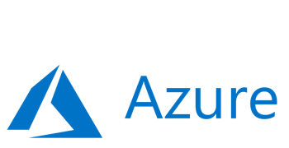
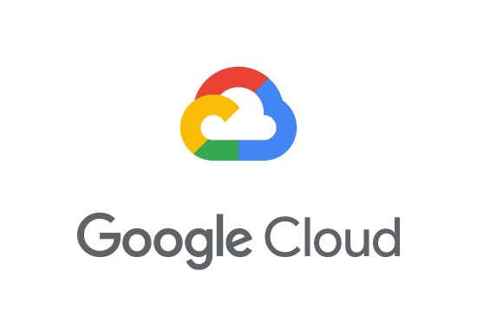
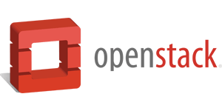
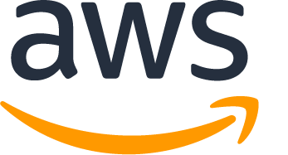
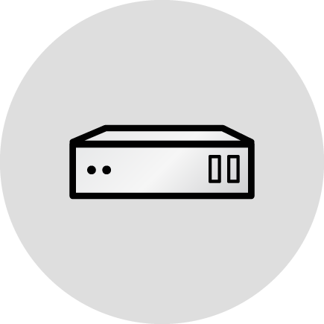
Underlying Infrastructures Quay can run
Quay can run on
standalone container host
(Tectonic) / Kubernetes / OpenShift
Quay runs on any public cloud infrastructure as well
Quay.io runs on AWS
Reference Architectures in planning

Slide 17
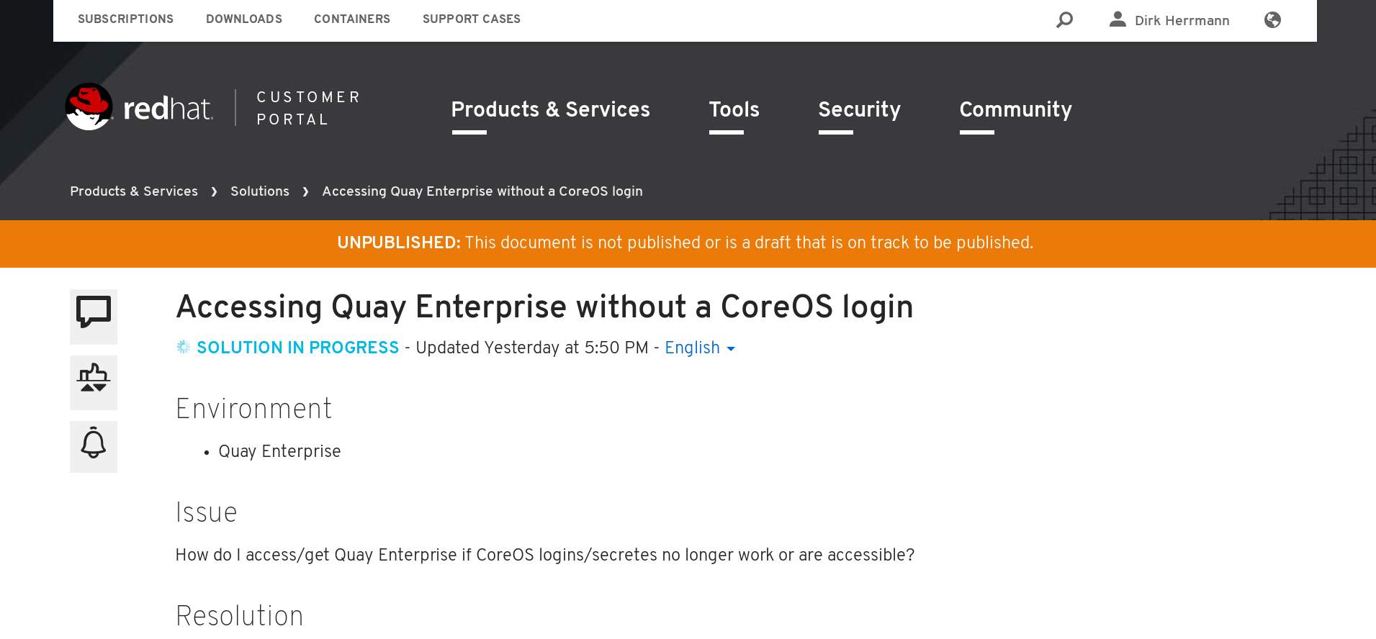
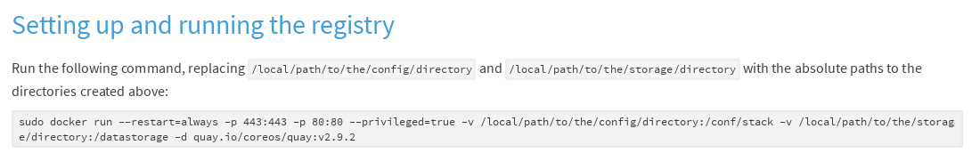
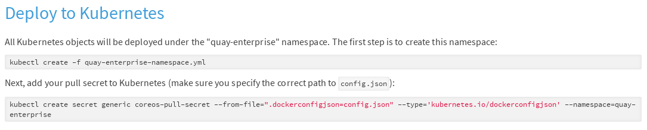
Underlying Infrastructure
Quay is shipped as container images
Images are distributed via Quay.io (will move to RHCC later)
Required secret to pull them in customer portal (requires login)
https://access.redhat.com/solutions/3533201
Install procedure documentation at
https://access.redhat.com/documentation/en-us/red_hat_quay/2.9/

Slide 18
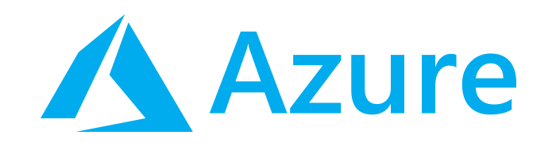
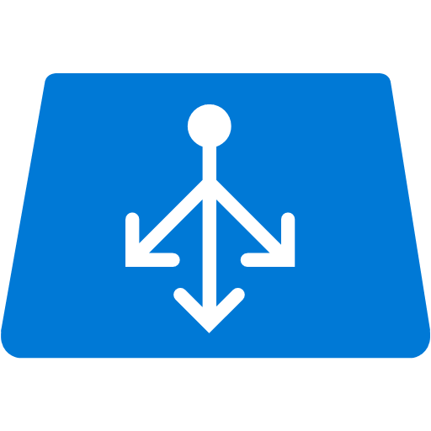




How to run Quay Microsoft Azure
Utilize Azure managed services such as HA PostgreSQL
Azure Blob Storage must be hot storage (not Azure Cool Blob Storage)
LOAD BALANCER
CLIENT
AZ 1
AZ 2
QUAY
QUAY
QUAY
QUAY
HA DATABASE
REDIS
BLOB STORAGE

Slide 19

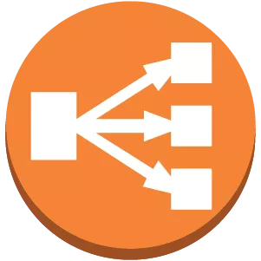
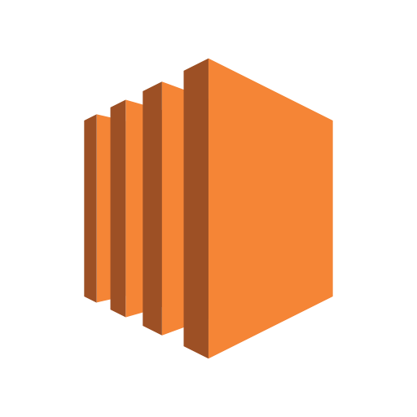

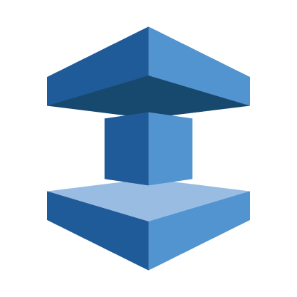
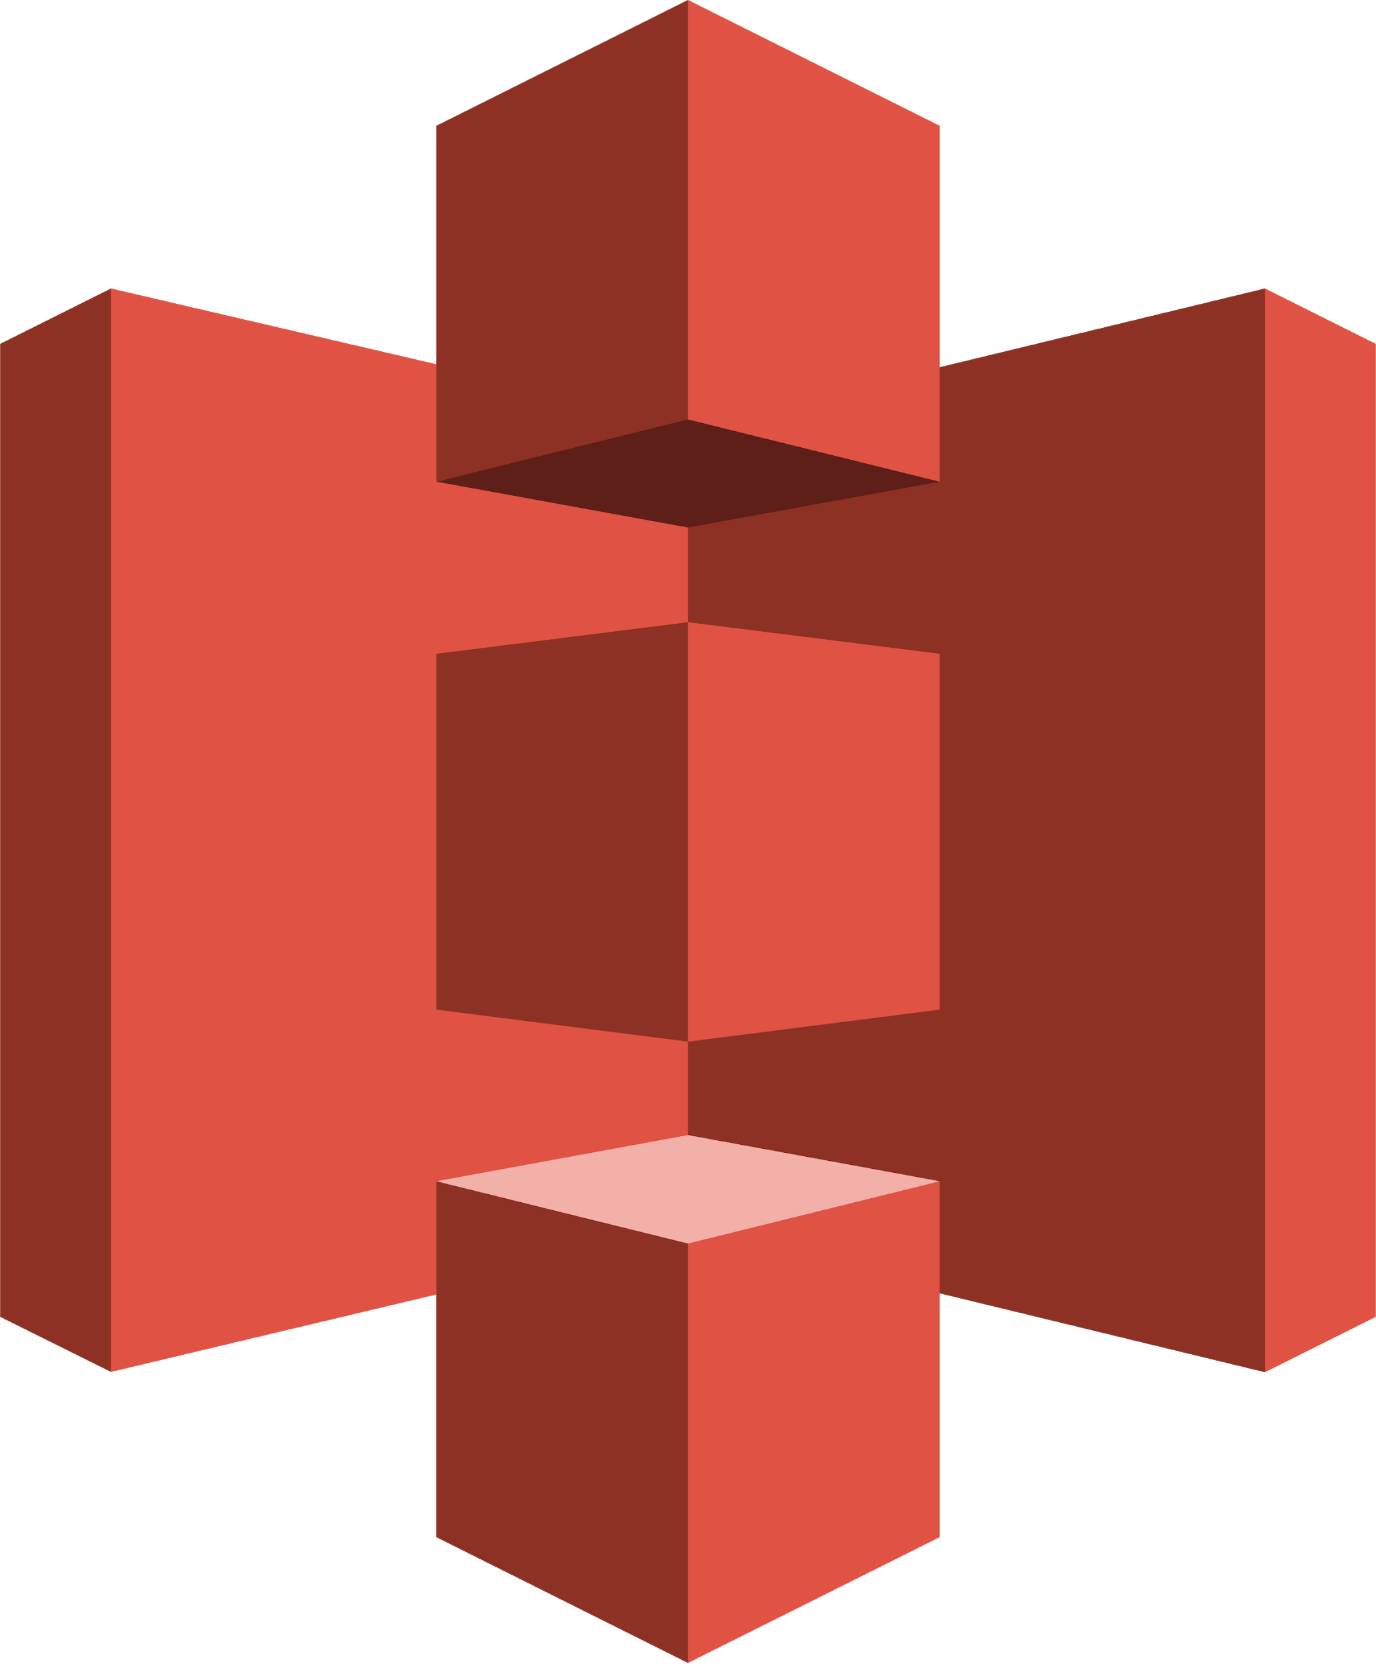
How to run Quay on AWS
AWS Elastic Load Balancer
AWS S3 blob storage (hot storage)
AWS RDS database
AWS ElastiCache Redis
EC2 VMs recommendation: M3.Large
CLIENT
AWS ELB
AZ 1
AZ 2
QUAY
QUAY
QUAY
QUAY
RDS
ELASTICACHE
REDIS
S3

Slide 20
Running Quay on OpenShift

Slide 21

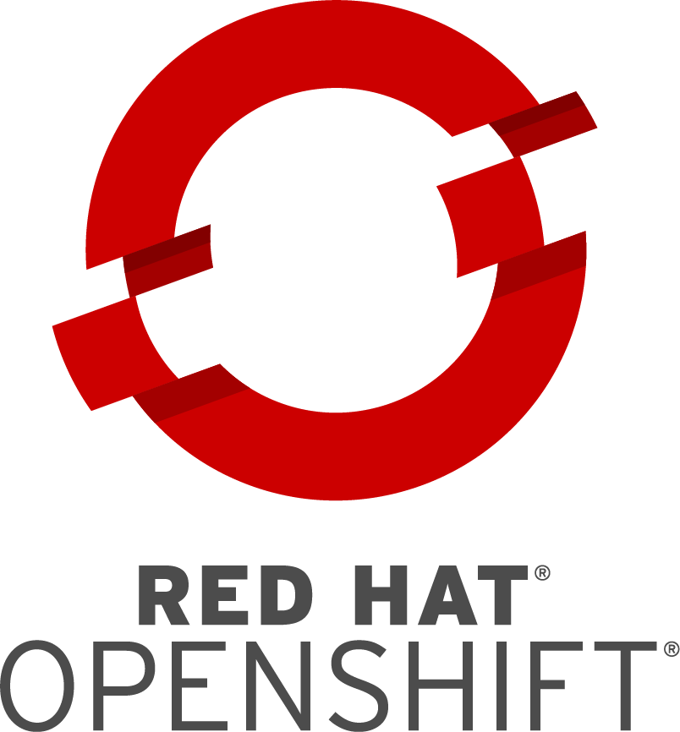

Quay on OpenShift: Recommended Setup
On OpenShift Cluster:
Quay Enterprise
Clair
Outside OpenShift cluster:
Database
Storage
Builders
BUILD WORKERS
CLAIR
QUAY
QUAY
REPLICATED DATABASE
DISTRIBUTED STORAGE

Slide 22
Getting Images into QUAY

Slide 23
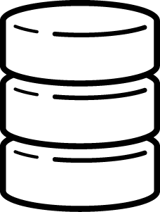
Getting Images into Quay Registry
Multiple ways to get images into Quay
Push images to Quay
Quay builders
Repository mirroring (coming soon)
Any compliant Docker client can push images into Quay
OpenShift build config
Docker CLI
Skopeo (recommended)
QUAY
push
push
mirror
DOCKER CLIENT
QUAY BUILDER
EXTERNAL REGISTRY
Notes:
skopeo is a command line utility that performs actions on container images and repositories, without needing the docker daemon
Advantage: it is simple and does NOT need docker daemon
Disadvantage: it’s currently only available as package on Linux
Docker CLI can be used to push images to Quay, provided the Docker daemon is installed and available
Advantage: it is available on all platforms
Disadvantage: it required Docker daemon to be running
Note that if SSL is not enabled on Quay Enterprise, you have to add Quay Enterprise to the list of insecure registries in Docker

Slide 24
REPLICATION and HA

Slide 25
Quay Geo-Replication
Description: Geo-replication allows for a single globally-distributed Quay Enterprise to serve container images from localized storage
How it Works:
Image data will be asynchronously replicated in the background to other storage engines
By default all images are replicated to all storage engines configured
CLIENT
1
QUAY
QUAY
QUAY
2
3
3
DISTRIBUTED STORAGE
DISTRIBUTED STORAGE
DISTRIBUTED STORAGE
New York
San Francisco
Berlin

Slide 26
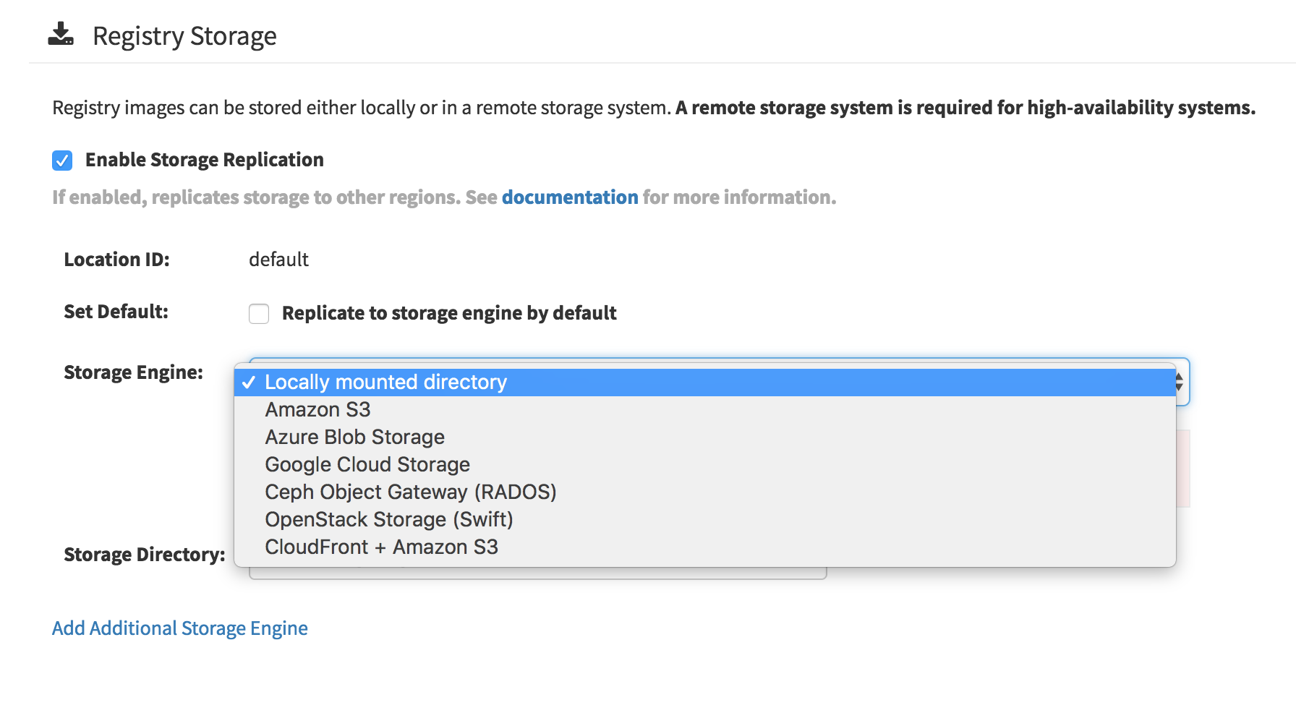
Quay Geo-Replication
Geo-Replication Requirements
Requires object storage engine in each geographic region
Local disk storage not supported
Each region must be able to access every storage engine
Contact support if geo-replication on a namespace level needed
All instances need to be connected to the same database
Note: Geo-replication occurs in the background. Images are NOT immediately localized in all storage engines and regions but are immediately pullable in all regions

Slide 27
Quay High-Availability Setup
Description: high-availability reference architecture prevents critical single PoF by running multiple instances of Quay
How it Works:
Stateful components in HA mode
Stateless components can be horizontally scaled arbitrarily
Note: Scaling out stateless components will add load to the stateful components, which must be accounted for in capacity planning.

Slide 28



Quay Components
REDIS
QUAY SERVER
CLAIR SCANNER
POSTGRESQL
DATABASE
BUILD WORKERS
DISTRIBUTED STORAGE
Color Guide
STATEFUL - HA NEEDED
STATEFUL - HA NOT NEEDED
STATELESS - HA NOT NEEDED
Notes:
Stateless
Quay Application Container
Clair Application Container
Quay Builder Image
Stateful (no HA necessary)
Redis instance/cluster
Stateful (HA desired)
Quay Database
Clair Database
Storage Engine

Slide 29
Quay High-Availability Setup
Required Dependencies:
a decent sized database with automatic backup and failover (Postgres HA, RDS)
a high available distributed storage engine such as S3, Ceph Rados or SWIFT
A redis server running on a medium sized machine (HA not required)
A load balancer capable of TCP passthrough.
At least three medium-sized machines for the cluster
Health checking instances: https://{instanceip}/health/instance (OK: 200)
Health checking cluster: https://{loadbalancer}/health/endtoend (OK: 200)
Autoscaling via monitoring metrics / thresholds

Slide 30
Authentication and
Authorisation

Slide 31
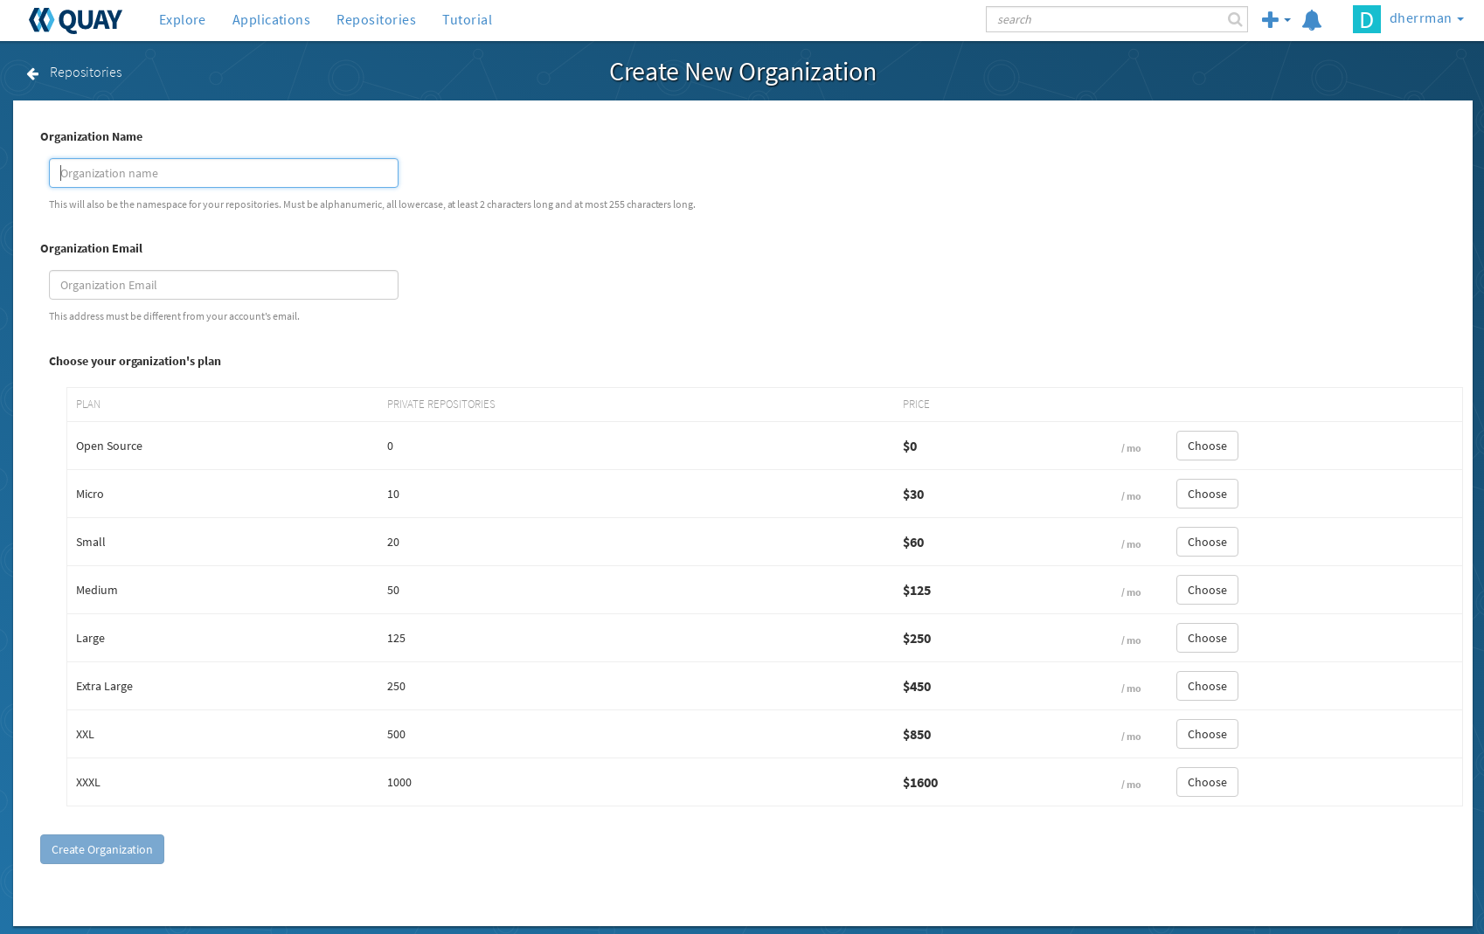
Organizations, Teams, Users, Robot Accounts
Organizations
sharing repositories under a common namespace that belongs to many users
are organized into a set of teams which provide access to repositories under that namespace
Teams
Provide a way for an organization to delegate permissions (both global and on specific repositories) to sets or groups of users
Permissions: Member, Creator, Admin

Slide 32
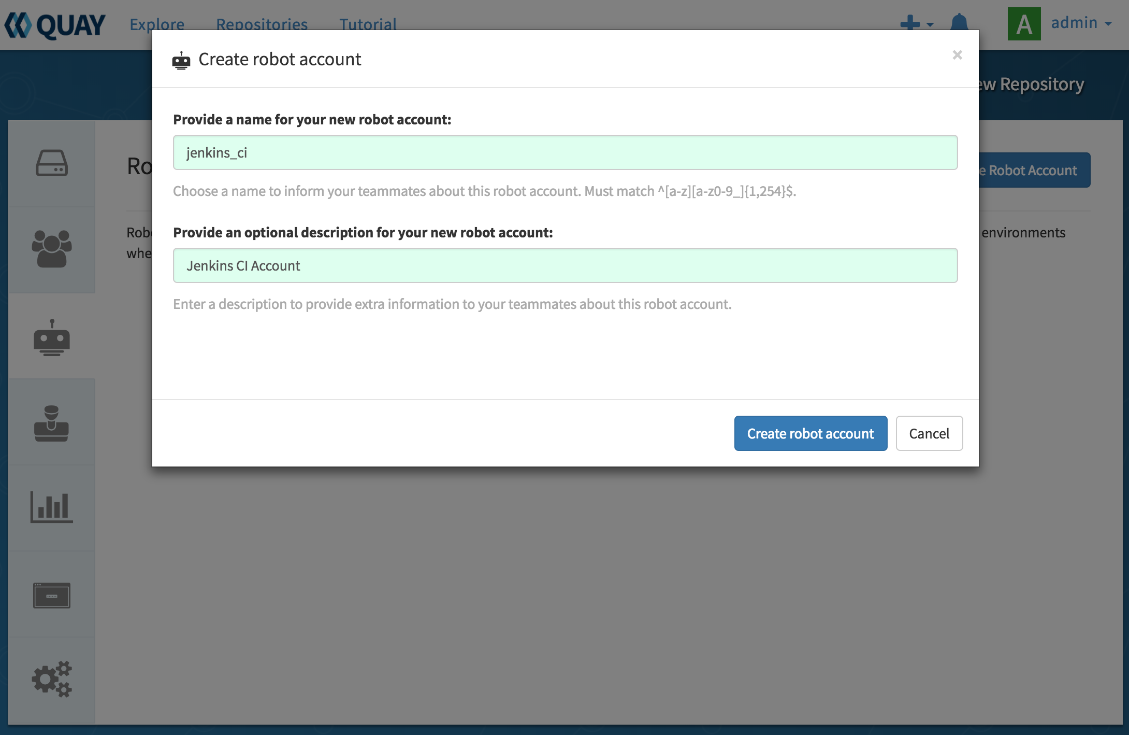
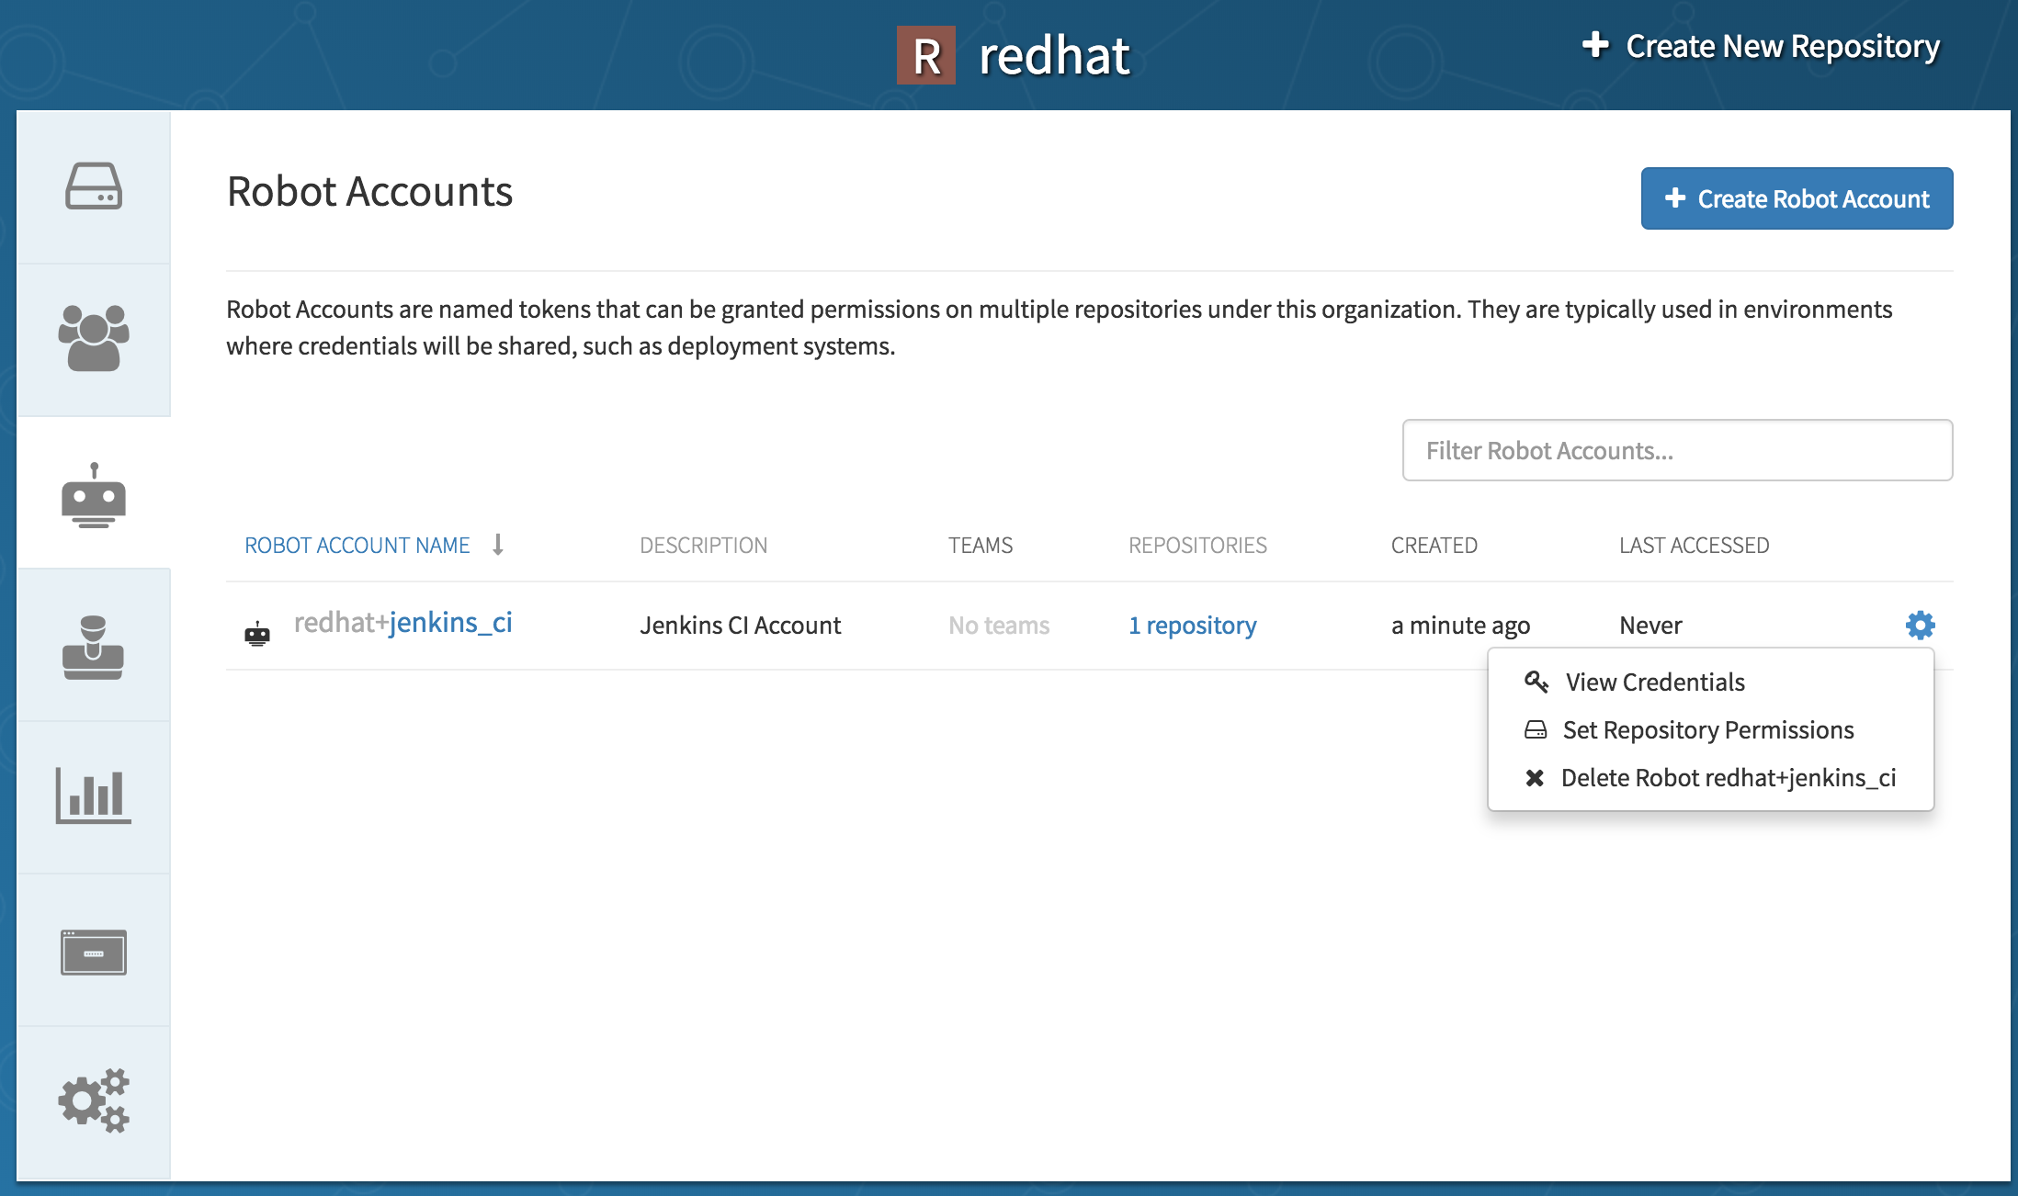
Organizations, Teams, Users, Robot Accounts
Users
Key element of setting repository permissions / RBAC
Robot accounts
Allow for automatic software deployments
Can be shared by multiple repositories owned by a user or organization
Managed inside the organization view -> Robot Accounts tab

Slide 33
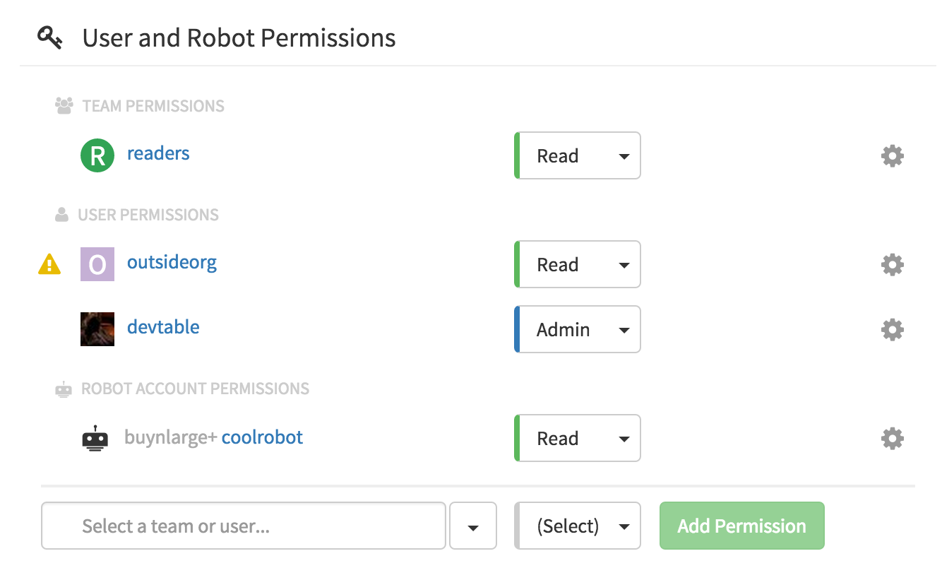
Repository Permissions
Define which users, robot accounts and teams have can
pull (read)
push (write)
Administer (admin)
Repository admins can
Add new permissions
Change existing permissions
Revoke permissions
Note: viewing and changing permissions requires repository admin permission.

Slide 34
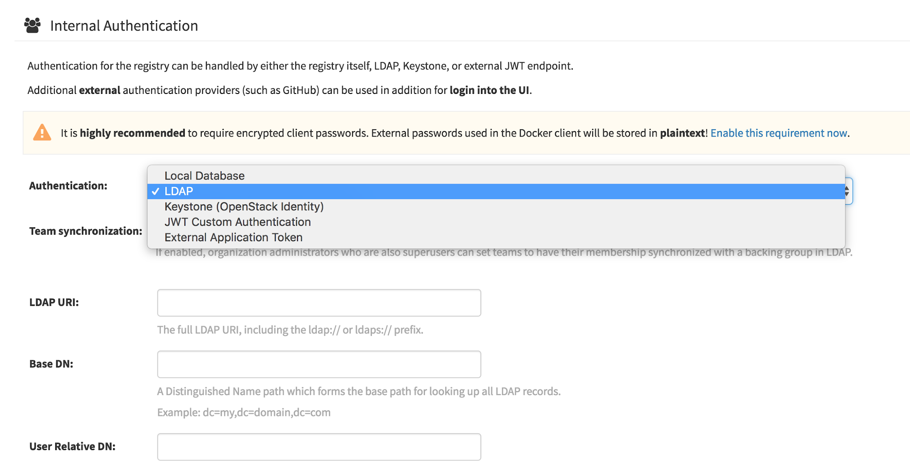
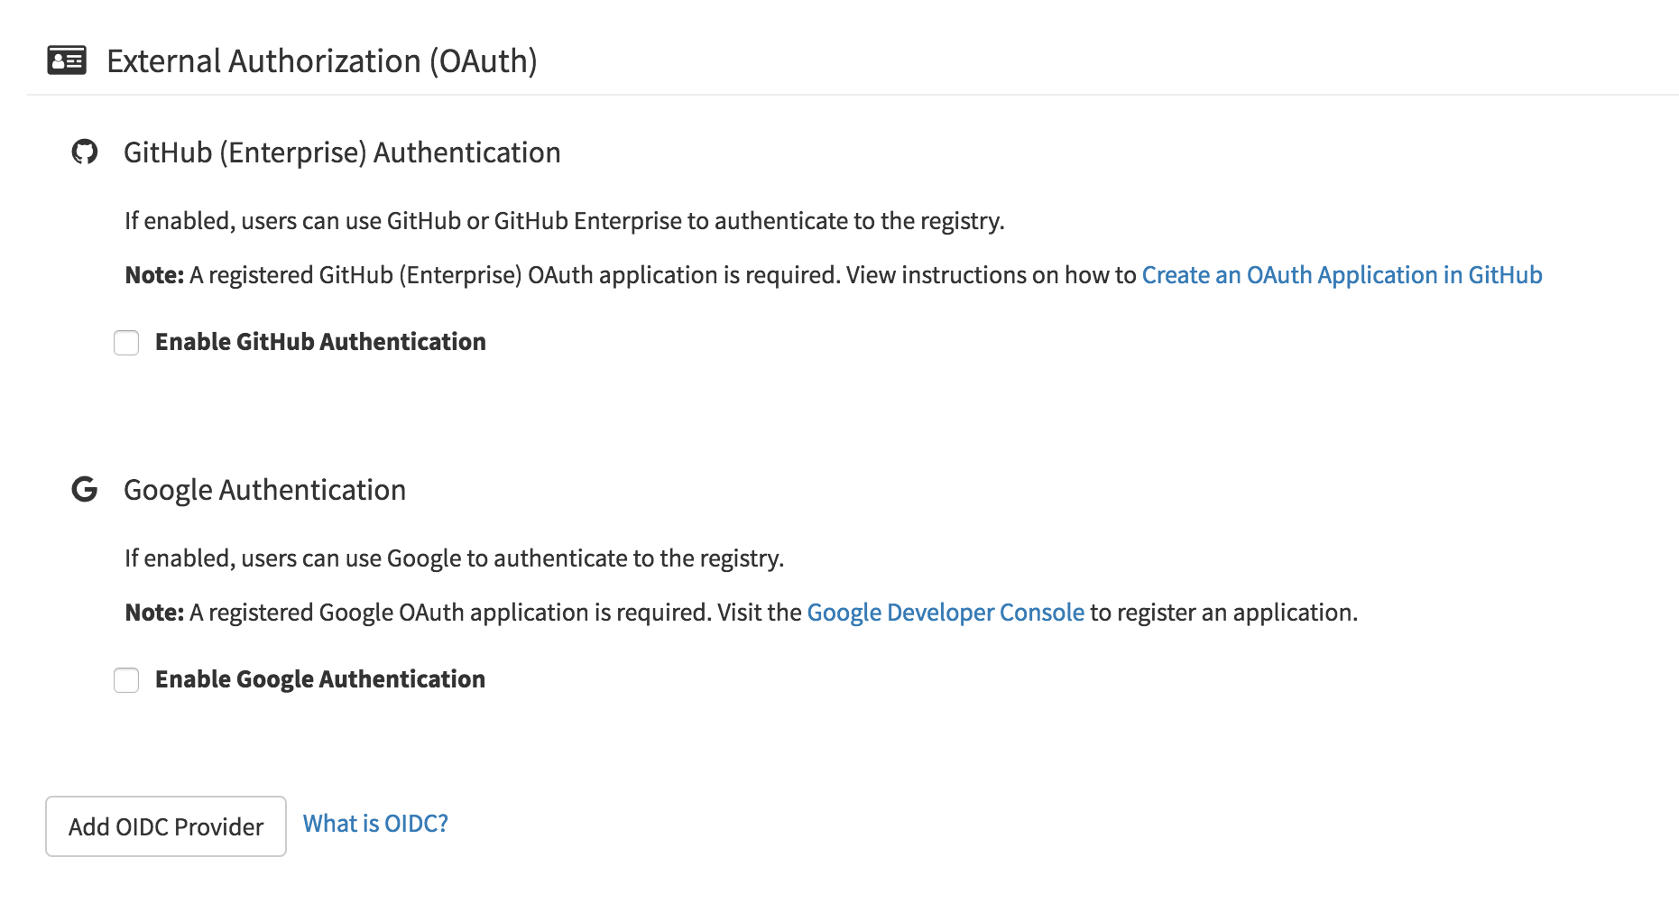
Enterprise Authorization and Authentication
Leverage existing identify mgt
Description: Red Hat Quay allows you to integrate your existing identity infrastructure and use a fine-grained permissions system to map to your organizational structure and grant access to whole teams to manage specific repositories.
Support auth providers:
Built-in Database Auth
LDAP auth and sync
External OIDC provider
OpenStack Keystone
Note: Auth integration for OCP coming soon.

Slide 35
Clair

Slide 36
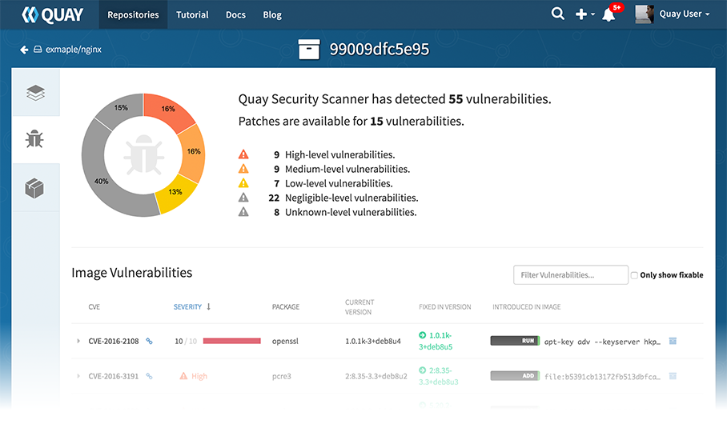
Clair Vulnerability Scanning
Complete Visibility into known vulnerabilities and how to fix them
Description: Quay integrates with Clair to continually scans your containers for vuln’s.
How it Works:
Static analysis of vulnerabilities
Multiple drivers and data sources
Synchronous update of vuln metadata
New vuln’s trigger notifications
Rich Clair API
Can run single-instance or HA

Slide 37
How to setup Clair - Step 3
Red Hat OVAL streams are configured by default
Clair v2 limited to one namespace (RHEL/Alpine or pip but not both)
Clair v3 will add support for other language level package managers (pip, npm, etc.) and additional namespaces (OS and languages)
Note: Users can’t add additional data sources without programming!
Note: Due to OVAL usage same limitations apply to Clair as to openSCAP (RHEL Base Chan only)

Slide 38
Thank you !

